Slide 1







Wales Climate Week 2025
Net Zero Activity

Slide 2















Greenhouse Gas Emission Sources

Slide 3



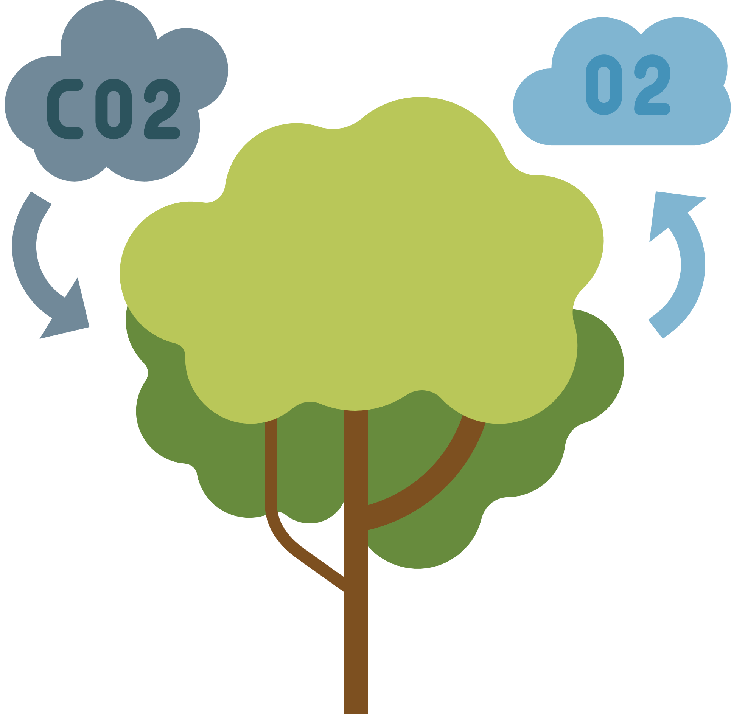


Greenhouse Gas Solutions

Slide 4

Match the Source to the Solution

