Slide 1


Consultation to Reorganise Saltney Ferry C.P and Saltney Wood Memorial C.P
Closing Saltney Ferry C.P and Saltney Wood Memorial C.P and opening a new maintained community primary school operating on the current two sites whilst a new building is approved and constructed.
Quick read/YOUNG PEOPLE DOCUMENT

Slide 2
Introduction
The Council is seeking your views on a proposal to reorganise Saltney Ferry C.P and Saltney Wood Memorial C.P.
The council proposes to deliver this reorganisation by:
. Closing Saltney Ferry C.P. and Saltney Wood Memorial C.P.
. Opening an amalgamated primary school initially on the current two sites, while a new building is approved and constructed.
. Opening a new 315 place Community English Medium Primary School on land currently occupied by Saltney Wood Memorial C.P.
Want more information?
If you would like to learn more about our plans, we have prepared a more detailed document. Follow this link https://www.flintshire.gov.uk/en/Resident/Schools/School-Modernisation-Related/Proposal-To-Reorganise-Saltney-Ferry-C.P-And-Saltney-Wood-Memorial-C.P.aspx
Consultation
Planning
Consideration

Slide 3




What are we doing?
The Council must follow certain processes when considering making significant changes to schools.
As part of these processes, we have started a formal discussion to ask for your views to help our decision-making process.
Your views are very important to us and will be given to the Council’s Cabinet when they decide upon reorganising primary school education at Saltney Wood Memorial C.P and Saltney Ferry C.P.
The United Nations Convention on the Rights of the Child (UNCRC) is a legally binding international agreement that outlines the civil, political, economic, social, and cultural rights of every child, regardless of their race, religion, or abilities. Article 12 states that young people have the right to express their views on matters affecting them, and for those views to be given due consideration.
Councillors will discuss your views, issues and the implications for reorganising primary school education at Saltney Wood Memorial C.P and Saltney Ferry C.P and then will decide what happens next.
Consultation
Planning
Consideration

Slide 4

Background
Saltney Ferry C.P. and Saltney Wood Memorial C.P. are two English-medium community primary schools serving the Saltney area. Both schools have historically been undersubscribed, and projections indicate this trend will continue. Undersubscribed schools are costly to operate and reflect a diminishing demand in the area. Additionally, both schools require expensive repairs, maintenance, and suitability improvements.
As the local authority, it is our duty to provide the right number of school places in the right area and ensure efficient and effective use of finances. Therefore, a proposal has been put forward to close and amalgamate the two schools into a single, state-of-the-art facility using the land attached to the current Saltney Wood Memorial C.P. site.
Consultation
Planning
Consideration

Slide 5
Why are we thinking about changing things?
The current provision of school places in the Saltney area does not align with the number of learners. Projections indicate this imbalance will continue, with too many places available relative to the learner population.
Saltney Ferry C.P. and Saltney Wood Memorial C.P. require significant repairs and maintenance to address issues with their buildings.
The local authority aspires to provide the best possible learning environments to help students thrive. It is believed that constructing a modern, first-class facility for the young people of Saltney can achieve this goal.
Amalgamating Saltney Ferry C.P. and Saltney Wood Memorial C.P. into a single school will generate cost savings through improved operational efficiency. This consolidation will also bring together the experience and expertise of staff from both schools into one institution.
Consultation
Planning
Consideration

Slide 6
What are we proposing?
The council is proposing to close Saltney Ferry C.P and Saltney Wood Memorial C.P and initially open an amalgamated primary school on the current school sites. This primary school would have a new name, new uniform, one governing body, one headteacher and one senior leadership team.
It is then proposed that the school will move into a new building on land attached to the current site at Saltney Wood Memorial C.P. The school would have 315 places along with 30 full time nursery places. It is anticipated that this provision would open in September 2028.
Consultation
Planning
Consideration

Slide 7
Other options
Status Quo -
This option would maintain the schools' existing structure and format.
Do the minimum -
The schools would undergo refurbishment based on the actions recommended in the most recent condition and suitability assessments, while maintaining their current structural configuration.
Amalgamate the two schools on their current sites while investing in their existing facilities.
Consultation
Planning
Consideration

Slide 8


What are the advantages and disadvantages of the proposal?
Advantages
Provides sufficient places to meet the needs of the local area. Significantly reduces running costs as there will now be one school rather than two. Establishes a new modern school with enhanced resources to provide better learning opportunities. Allows the opportunity for both schools to come together as one taking the experience and best practice at both to improve learning outcomes for children
Disadvantages
Closure of both schools in their current format and the loss of Saltney Ferry C.P altogether. Potential redundancies with move from two schools to one. Impact of travelling distance on those currently attending Saltney Ferry C.P who would now have to travel to a new school on the Saltney Wood Memorial site.
Consultation
Planning
Consideration

Slide 9
Timescales
Stage of Process | Key Dates*
Formal Consultation | Tuesday 3rd June 2025 to Friday July 18th 2025.
Cabinet consider the results of the consultation and determines whether to proceed with proposals | September/October 2025
Council publish statutory notice and enter into objection period | September/October 2025
Cabinet consider the objection report and determine whether or not to implement the proposals | January/February 2026
Decision notification letter is issued with outcome from Cabinet determination | January/February 2026
Consultation
Planning
Consideration
* these dates may be subject to alteration dependent on cabinet approvals.

Slide 10

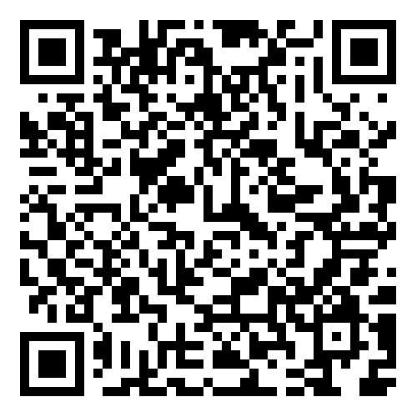

Tell us what you think
We really want to know what you think of the proposal
You can let us know through a number of ways. 
If you would like a paper copy of this document or further information please contact us at
saltneyconsultations@flintshire.gov.uk
or call
01352 704018/704014
 Online
Using the link to survey
https://www.smartsurvey.co.uk/s/saltneyprimaryreorganisation/
QR Code
You can respond to the survey online by
scanning the QR code
 Paper
You can respond in writing to:
School Modernisation Team, Ty Dewi Sant, St David’s Park, Ewloe, Flintshire, CH5 3TX
Further information can be found at
https://www.flintshire.gov.uk/en/Resident/Schools/School-Modernisation-Related/Proposal-To-Reorganise-Saltney-Ferry-C.P-And-Saltney-Wood-Memorial-C.P.aspx
Thank You!
You can tell us what you think from Tuesday June 3rd 2025. You must respond by midnight Friday July 18th.

